Slide 1
Motion Analysis, Ray Tracing & Optical Flow

Slide 2
Overview
Motion Analysis in Computer Vision
Understanding motion between frames
Optical flow computation and analysis
Object tracking systems and applications
Introduction to Ray Tracing
Fundamentals of light transport
Mathematical foundations
Modern rendering techniques

Slide 3
Understanding Motion in Computer Vision
Computer vision helps machines understand movement and objects in videos, just like how humans track moving objects with their eyes.
When you watch a video, your brain naturally tracks moving objects. However, computers need special algorithms to understand this movement. We analyze how pixels change position between video frames
Basic Concept of Motion:
Motion is the change in position of objects between video frames
Think of a video as a series of photos taken very quickly
We need to understand where objects move between these photos

Slide 4
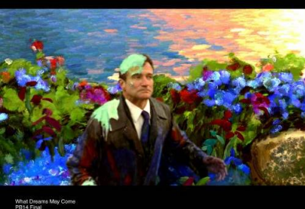
Why estimate motion?
We live in a 4-D world (x,y,z,t)!
Wide applications:
Motion detection and object tracking (surveillance etc.)
Correct for camera jitter (stabilization)
Align images (panoramic mosaics)
3D shape reconstruction (shape from motion)
Video compression (MPEG)
Robotics (navigation etc.)
Entertainment: Special Effects, Sportscasting, Video Games

Slide 5
Types of Motion in Computer Vision
Basic Types of Motion:
Translation: Objects moving in straight lines without changing orientation
Example: A car moving straight down a highway
Can be measured with (dx, dy) displacement vectors
Simplest type of motion to track and analyze
Rotation: Objects spinning or changing orientation
Example: A satellite rotating in space
Measured by angle of rotation (θ)
Can occur around different axes (X, Y, Z)
Scaling: Objects getting larger or smaller
Example: A person walking towards or away from camera
Changes in apparent size due to distance
Measured by scale factors in X and Y directions

Slide 6
Types of Motion in Computer Vision
Complex Motion Types:
Articulated Motion: Connected parts moving relatively
Example: Human body movements, robot arms
Multiple rigid parts connected at joints
Each part can have independent rotation and translation
Non-Rigid Motion: Objects changing shape while moving
Example: Clothing moving in wind, facial expressions
Shape deformation along with position changes
More challenging to track and analyze
Periodic Motion: Regular repeating patterns
Example: Walking cycles, rotating fan blades
Motion that repeats at fixed intervals
Can be analyzed using frequency-based methods

Slide 7
Types of Motion in Computer Vision
Camera-Based Motion:
Camera Translation: Camera moving through space
Creates apparent motion of entire scene
Example: Drone flying forward
Camera Rotation: Camera changing viewing direction
Creates complex apparent motion patterns
Example: Pan and tilt movements in surveillance
Combined Camera Motion: Mix of rotation and translation
Most common in real-world scenarios
Example: Hand-held camera movements

Slide 8
Introduction to Optical Flow
One of the fundamental techniques used to analyze this motion - Optical Flow.
Understanding Optical Flow-
Imagine looking out of a moving train - everything seems to flow past you
Optical flow measures this apparent motion for every pixel
It creates a "motion map" showing where everything is moving

Slide 9
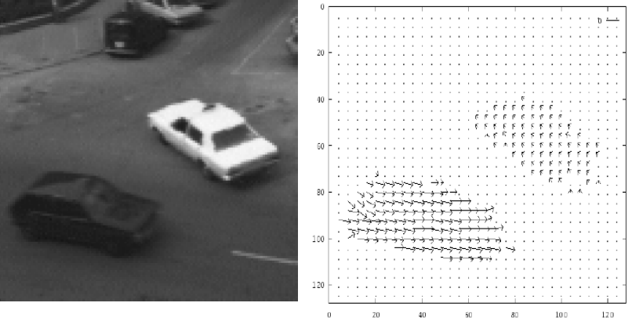
Introduction to Optical Flow
How Optical Flow Works (simplified):
Takes two consecutive video frames
For each pixel, finds where it moved to in the next frame
Creates arrows (vectors) showing direction and speed of motion
Example- Hamburg Taxi Sequence

Slide 10
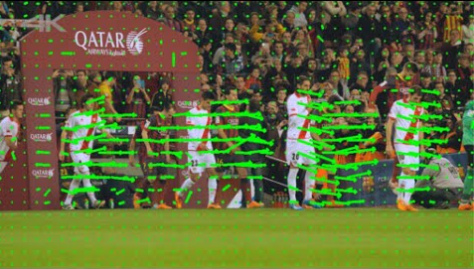
Visualizing Optical Flow in Sports Analysis
The green arrows show the direction and magnitude of motion
Each arrow represents the movement of players and objects on the field
Motion vectors help track player movements and analyze game patterns

Slide 11
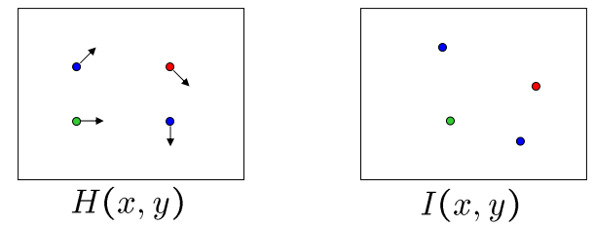
Estimating optical flow
How to estimate pixel motion from image H to image I?
Solve pixel correspondence problem
given a pixel in H, look for nearby pixels of the same color in I
Key assumptions-
Color constancy: a point in H looks the same in I – For grayscale images, this is brightness constancy
Small motion: points do not move very far
Spatial coherence: points move like their neighbors

Slide 12
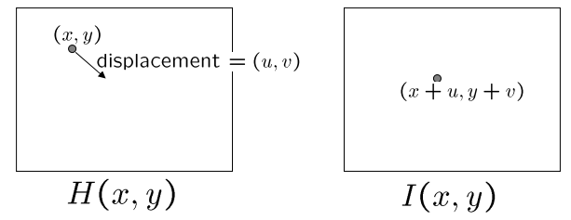
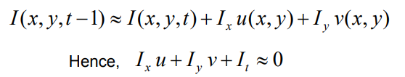
The brightness constancy constraint
Let’s look at these constraints more closely
Brightness constancy:
Linearizing the right side using Taylor expansion:

Slide 13


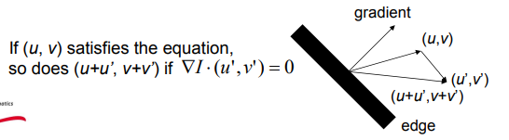
The brightness constancy constraint
How many equations and unknowns per pixel?
– One equation, two unknowns (makes the problem under-constrained)
What does this constraint mean?
The component of the flow perpendicular to the gradient (i.e., parallel to the edge) is unknown

Slide 14
Optical Flow Equation Challenges
The optical flow equation:
Gives us one equation per pixel
But we have two unknowns (u,v) per pixel
This makes the problem under-constrained
Why is this a problem?
Cannot solve for unique flow vector
Multiple possible solutions exist
Need additional constraints
This leads us to two key issues:
The Aperture Problem (coming up next)
Need for additional assumptions and constraints
Solutions involve:
Looking at neighboring pixels
Making assumptions about motion
Using different mathematical approaches

Slide 15
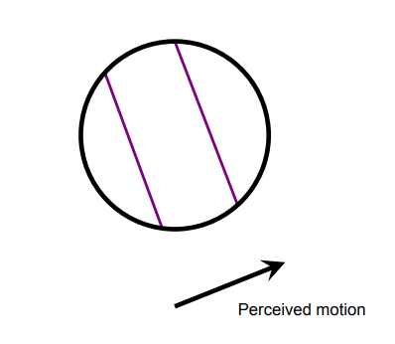
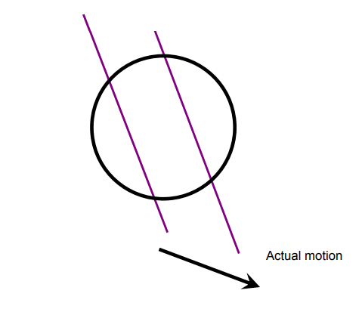
The aperture problem
The aperture problem occurs when viewing motion through a limited window (aperture) like looking at a moving object through a small circular opening
Circle represents our limited viewing window (aperture), purple lines represent an edge or feature we're tracking, black arrows show motion vectors
What We See vs Reality:
Actual Motion: The true movement is diagonal/downward
Perceived Motion: We only detect horizontal movement
Can only measure motion perpendicular to the edge
Component parallel to the edge is invisible
This is a fundamental challenge in optical flow computation

Slide 16
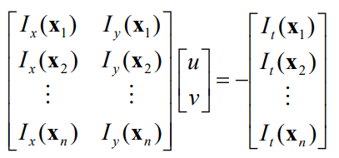
Solving the aperture problem
How to get more equations for a pixel?
Spatial coherence constraint:
pretend the pixel’s neighbors have the same (u,v)
E.g., if we use a 5x5 window, that gives us 25 equations per pixel

Slide 17
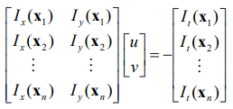



Lucas-Kanade flow
Linear least squares problem-
Solution given by

Slide 18
Methods of Optical Flow
Lucas-Kanade Method:
Assumes flow is constant in a local neighborhood
Solves aperture problem by combining constraints from multiple pixels
Works well for small motions
Advantages: Robust to noise, computationally efficient
Limitations: Fails with large motions
Horn-Schunck Method:
Global smoothness assumption
Minimizes distortion in flow and deviations from data
Creates denser flow fields
Advantages: Dense flow field, works well for transparent motion
Limitations: More sensitive to noise

Slide 19
Sparse vs. Dense Optical Flow
Sparse Optical Flow:
Tracks specific key points (e.g., corners, edges).
Less computationally intensive.
Example: Monitoring selected points on a moving car.
Dense Optical Flow:
Estimates motion for every pixel.
More detailed but computationally expensive.
Example: Visualizing entire flow fields in weather simulations.

Slide 20
Optical Flow Algorithm Steps
Pre-processing:
Image smoothing to reduce noise
Convert to grayscale if needed
Gradient Computation:
Calculate spatial gradients (Ix, Iy)
Calculate temporal gradient (It)
Flow Computation: For Lucas-Kanade:
Define window size
Compute local motion vectors
Solve least squares equations
For Horn-Schunck:
Initialize flow field
Iteratively update estimates
Apply smoothness constraint
Post-processing:
Filter outliers
Smooth flow field
Visualize results

Slide 21
Applications of Optical Flow
Traffic Analysis: Detecting vehicle speeds and trajectories.
2. Sports Analytics: Tracking player movements during a game.
3. Video Stabilization: Correcting shaky camera footage.
4. Action Recognition: Understanding human activities in video sequences.

Slide 22
Introduction to Ray Tracing
Ray tracing is a technique for rendering three- dimensional graphics with very complex light interactions. This means you can create pictures full of mirrors, transparent surfaces, and shadows, with stunning results.
A very simple method to both understand and implement.
It is based on the idea that you can model reflection and refraction by recursively following the path that light takes as it bounces through an environment

Slide 23
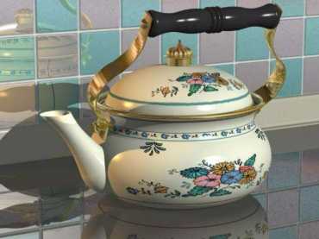
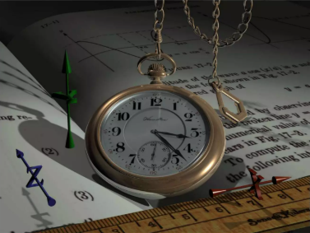
Raytraced Images

Slide 24
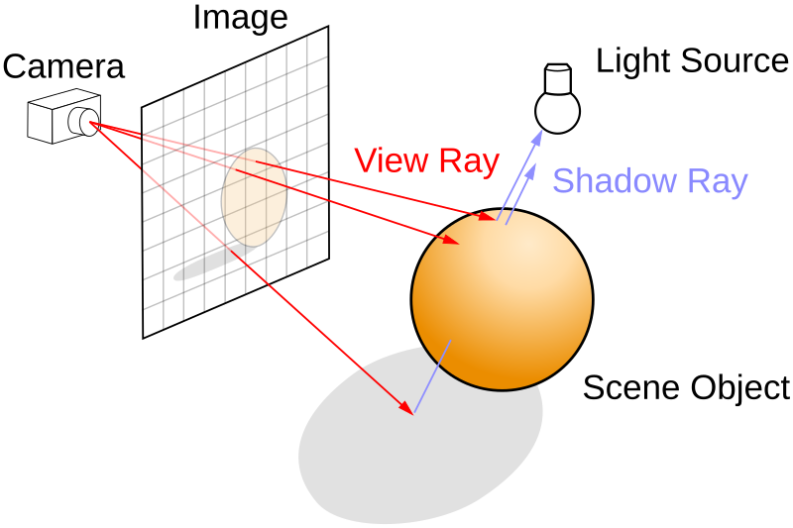
Ray Tracing Model
Source- Wikipedia
Key Components: Camera (white box on left), Image plane (gray grid), Scene object (orange sphere), Light source (white bulb)
View Ray (Red):
Originates from camera/eye
Passes through image plane pixels
Intersects with objects in scene
Shadow Ray (Blue):
Cast from object intersection points
Points toward light source
Determines shadow calculations

Slide 25
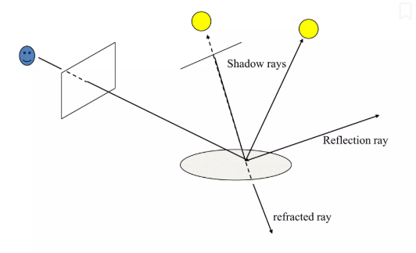
Ray Tracing
Primary Ray (View Ray):
Cast from camera through image plane
Determines what camera sees
First point of intersection with objects
Shadow Rays:
Cast from intersection points to light sources
Used to determine if point is illuminated
Multiple rays for multiple light sources
Secondary Rays:
Reflection Ray:
Bounces off surface at equal angle
Creates mirror-like reflections
Refraction Ray:
Passes through transparent materials
Changes direction based on material properties
Creates glass/water effects

Slide 26
Ray Tracing Algorithm
Builds the image pixel by pixel Cast additional rays from the hit point to determine the pixel color
Shoot rays toward each light. If they hit something, the object is shadowed from that light, otherwise use "standard model" for the light
Reflection rays for mirror surfaces, to see what should be reflected in the mirror
Refraction rays to see what can be seen through transparent objects
Sum all the contributions to get the pixel color

Slide 27
Ray Tracing Hardware Implementation
Ray tracing has moved from offline rendering to real-time applications thanks to specialized hardware acceleration in modern GPUs and advanced software frameworks.
Why Hardware Acceleration for Ray Tracing?
Performance Needs:
Ray tracing involves complex calculations (e.g., ray intersections, shading).
Real-time rendering demands efficient computation.
Modern GPU Support
NVIDIA RTX Series (2000, 3000, 4000 series)
AMD Radeon RX 6000 & 7000 series
Intel Arc GPUs
Dedicated RT (Ray Tracing) cores

Slide 28
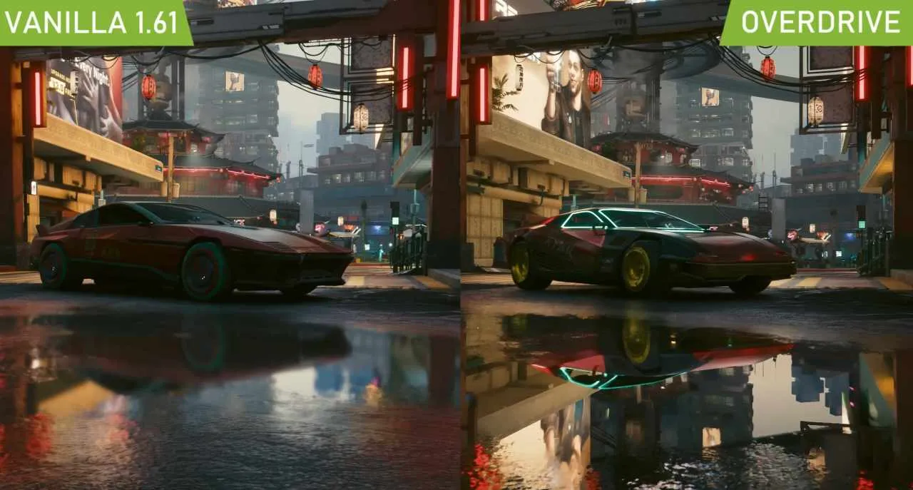
Ray Tracing: Applications and Usage
Ray Tracing in video games

Slide 29
Ray Tracing: Applications and Usage
Entertainment & Media
Video games: Real-time graphics, shadows, reflections
Films: Special effects and photorealistic animation
VR/AR: Immersive visual experiences
Professional Applications
Architecture: Building visualization and lighting design
Product Design: Virtual prototyping and showcasing
Scientific: Medical imaging and research visualization

